Slide 1
Assessment of Monitoring Tools
PROJECT WORK ON INFRASTRUCTURES FOR CLOUD COMPUTING AND BIG DATA

Slide 2
INTRODUCTION
In the last few years, Cloud Computing has become an even more widespread concept through corporations and organizations, the possibility to acquire on-demand services over the internet as software, platforms and infrastructures is a solid reality.
Examples of Iaas:
Amazon EC2
AWS
Microsoft Azure
Openstack
Monitoring is critical given the complexity of Cloud Computing systems!
We need information about the physical and the virtual platform, and we can do that using metrics. This presentation will briefly introduce monitoring in Cloud Computing Systems with a focus on Prometheus, and then monitoring on the Openstack Platform, with a focus on Monasca.

Slide 3
CLOUD MONITORING
Some examples:
Nagios
DARGOS
Zabbix
Prometheus
Prometheus is a leading open source monitoring and alerting tool. Since 2012 it has become a very popular software, maintained independently of any
Company.
The software was created because of the need to monitor multiple microservices that might be running in the system.
It was the second project to be accepted by the CNF after Kubernetes.

Slide 4
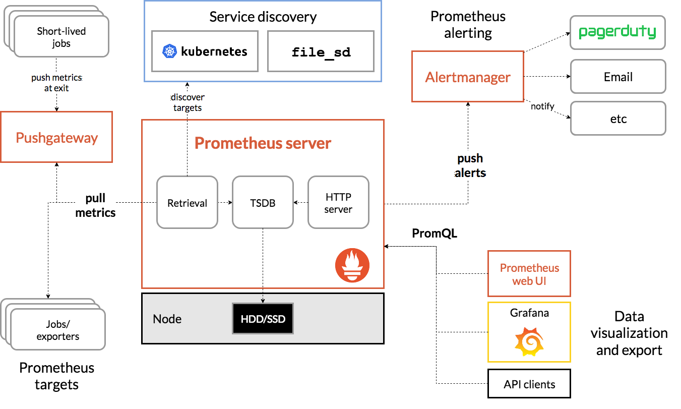
PROMETHEUS ARCHITECTURE

Slide 5
Data Model
Prometheus stores all data as time series: a unique stream of time-stamped values, identified by the same metric and the same set of labels, an optional key-value pair.
The metric name specifies the general feature of a system that is measured.
< metric name >{ < label name >= < label value > , ...}
Libraries
The Prometheus server does not yet make use of the type information and flattens all data into untyped time Series. Four types are available:
Counter
Gauge
Histogram
Summary
Vocabulary
Instance = target that can be scraped, a single process.
Job = collection of instances with the same purpose

Slide 6
Targets
Can be on the same machine as the Prometheus server or external.
localhost:<port>
OR
<IP ADDRESS>:<port>
Configuration
Download and extract it. Then modify the prometheus.yml configuration file.
static_configs section to define the targets.
Only static discovery is allowed from here.
Exporters
Libraries and integrations which help in exporting existing metrics from third-party systems as Prometheus metrics.

Slide 7
Exporter > ALERT MANAGER
INTEGRATION WITH GRAFANA
Any datasource
can be selected, and then any number of dashboard can be defined.
Has to be manually installed and configured.
Handles alerts sent by client applications such as the Prometheus
server. It takes care of:
Grouping
Inhibition
Silence
High Availability

Slide 8
OPENSTACK CLOUD MONITORING
IAAS. OpenStack is a cloud computing system that controls large pools of compute, storage and networking resources spread over a datacenter, all managed using APIs and common authentication mechanisms.
Openstack environments can include a lot of physical nodes, mononitoring is vital to process management!
Modular architecture. To provide a set of core services to facilitate scalability and elasticity.
COMPUTE - OBJECT STORAGE - BLOCK STORAGE - NETWORK - DASHBOARD - IDENTITY
MONASCA - CEILOMETER

Slide 9
Ceilometer
Within OpenStack exists a telemetry project that provides a framework to meter and collect infrastructure metrics such as CPU, network, and storage utilization. This project aims to provide the infrastructure needed to collect measurements within OpenStack and then send them to different targets.
Ceilometer works with many other components, but is not efficient for fine grained monitoring. Ceilosca was born from the integration between Ceilometer and Monasca.
Monasca
Large framework that involves all aspects of monitoring, including alarms, statistics, measurements specifically for all OpenStack components.
Defined as Monitoring as a Service:
Allows tenants to define what should be measured and statistics to be collected.
It is easier to configure that Ceilometer.

Slide 10
MONASCA ARCHITECTURE

Slide 11
Metrics
Uniquely identified by a name and a specific set of dimensions. The dimension is identified by a (key, value) pair. A measurement is a metric instance with a value and a timestamp.
Metrics can be defined manually from the Monasca CLI using the monasca metric-create
command.
Notifications
Through either the Horizon Dashboard or using the Monasca CLI, notifications can be created.
Integration with Slack, email and HipChat.
Plugins
Integration with Grafana platform.
Libvirt plugin
Alarms
Identified by a severity level (LOW, MEDIUM, HIGH, CRITICAL) and an expression, composed by a mathematical function, a metric, a comparator and a threshold.

Slide 12
EXPERIMENTAL RESULTS
1 - Prometheus:
Deployment
Monitoring test
Linux Host monitoring with Node Exporter and Pushgateway
2 - Monasca:
Deployment
Monitoring test

Slide 13
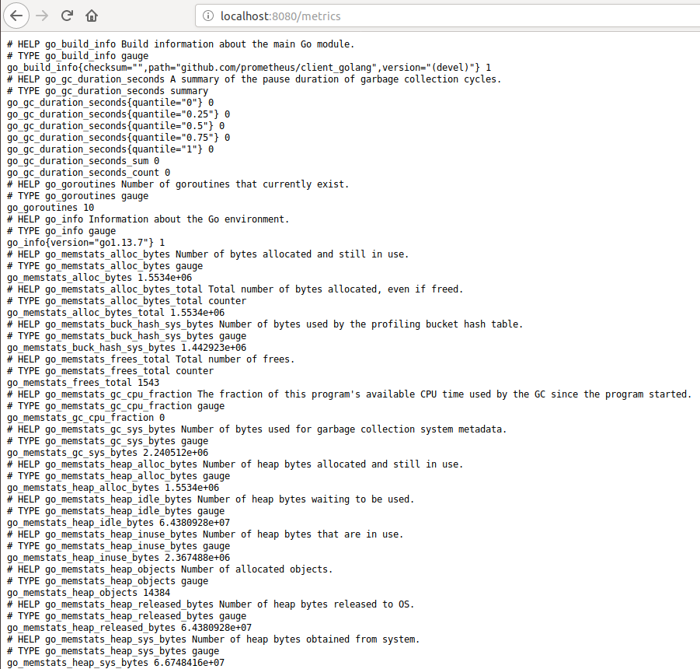
1 - PROMETHEUS
To deploy Prometheus the prometheus.yml file has to be configured and then run from the terminal.
Prometheus will be available from the address configured.
Using the target address metrics will be available
(not really reader friendly).

Slide 14
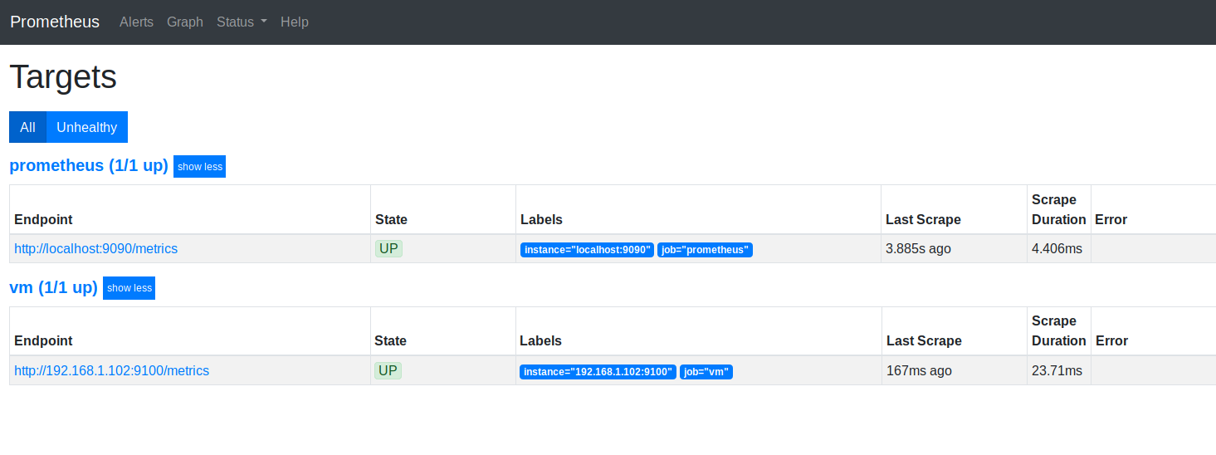
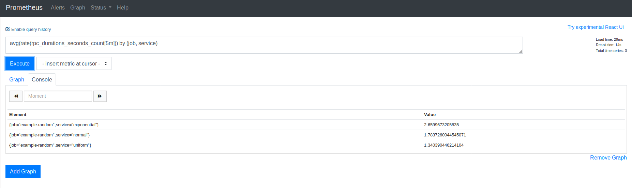
Metrics can be used to make queries and monitor the state of the machine using the Expression Console. The output is identified by job and service tags.

Slide 15
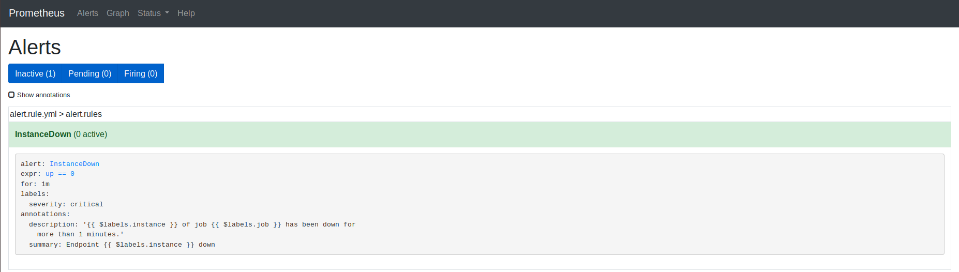
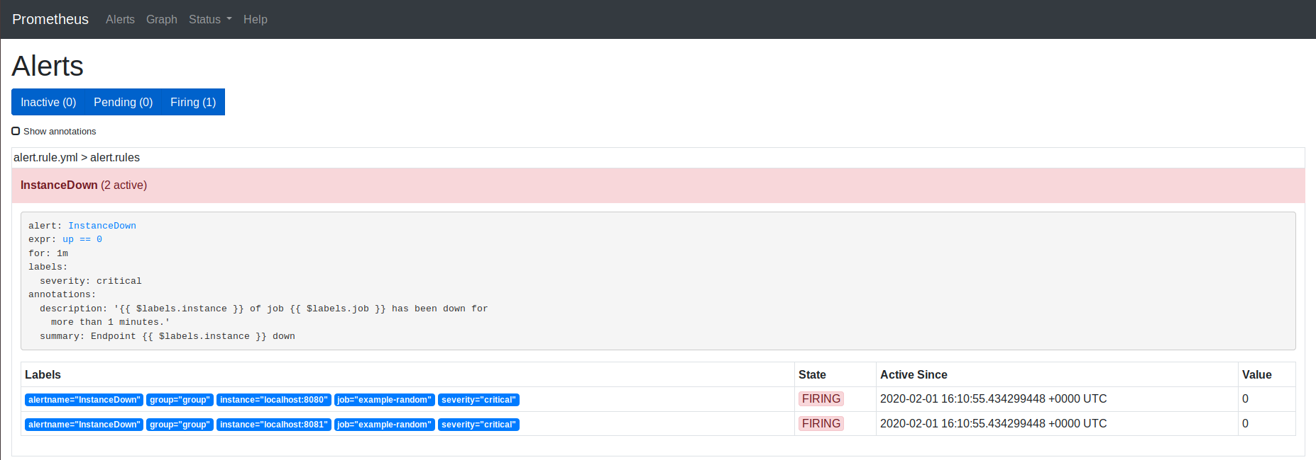
The Alert Manager was also configured to create a simple alert: if the target was down the alert would be fired.

Slide 16
LINUX HOST MONITORING
> Node Exporter
The exporter has to be downloaded and configured on the target host.
When the node exporter is up the Prometheus server will receive the metrics and can process them exactly in the same way as it was shown in the previous slides.
Useful for batch jobs that are related to a machine. For short lived jobs, where metrics cannot be scraped, the Pushgateway could be extremely helpful.
> Pushgateway
Was used to replicate the tracking of performance metrics that happens on servers, it is also a scalable solution.
The cpu and memory usage were monitored, as well as the processes that weighed the most on performances.
PromQL was used to query the Prometheus Server.

Slide 17
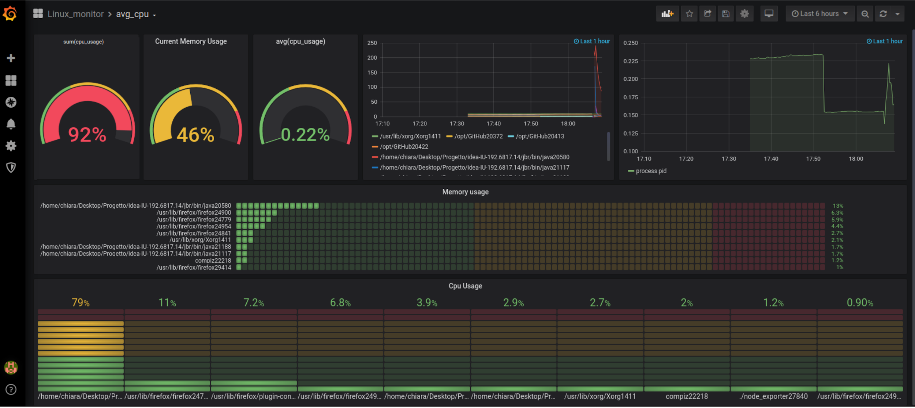

Slide 18
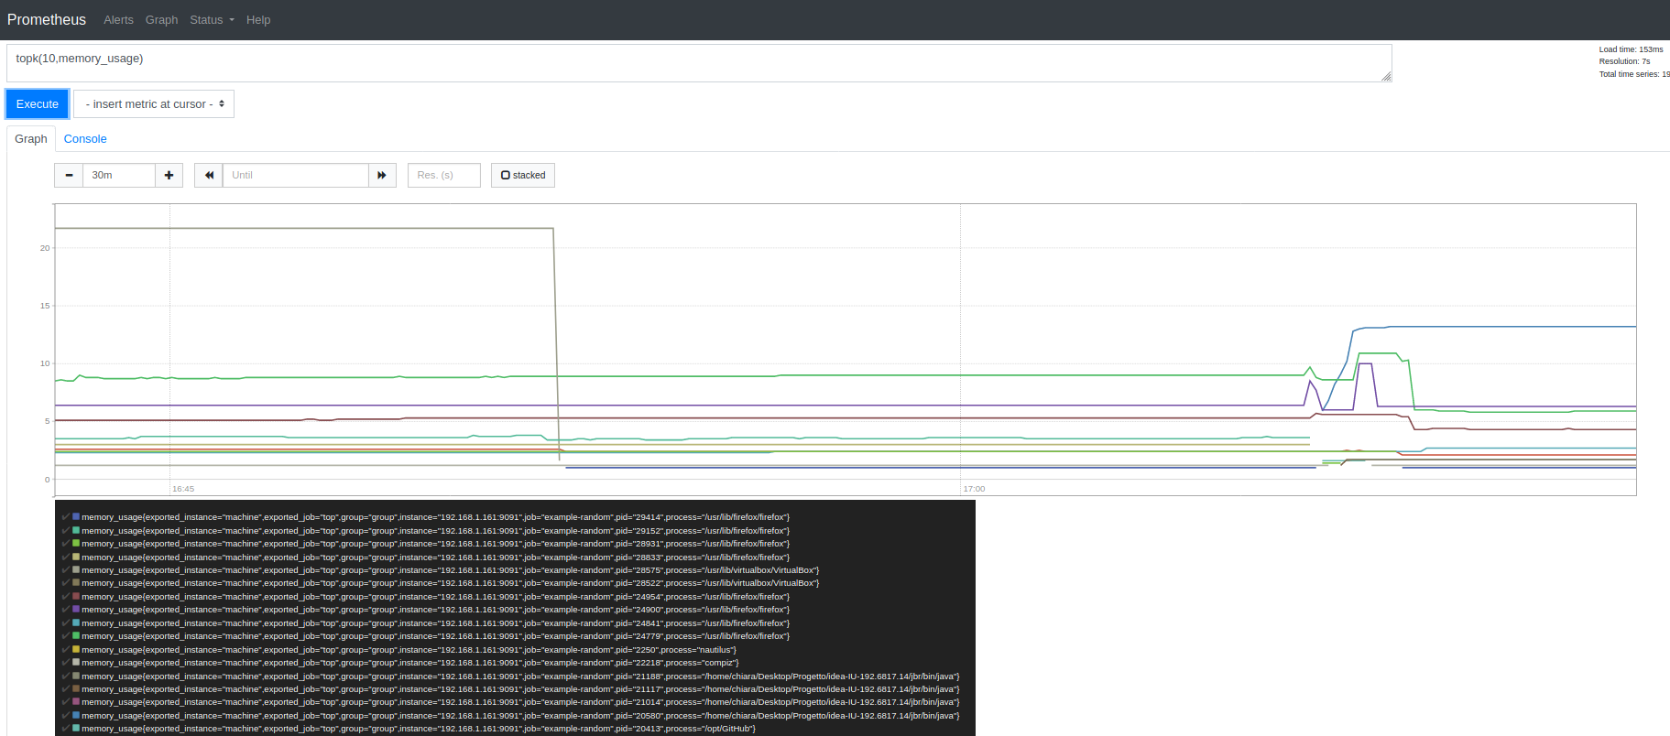
The same result..but using Prometheus UI

Slide 19
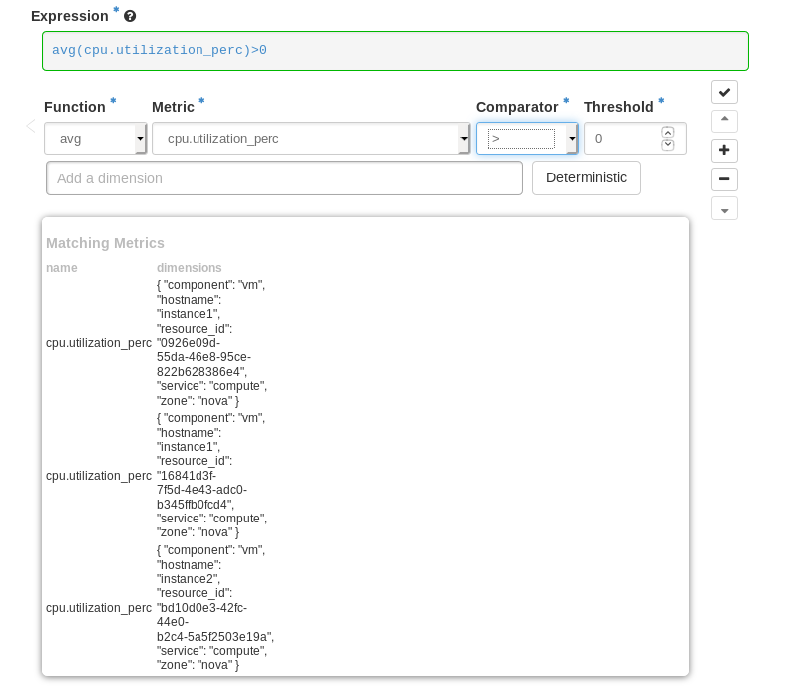
2 - MONASCA
Monasca was deployed using the Monasca API Devstack plugin (not production ready, development only). Configured using the local.conf file and then run from terminal.
Then access using the credential from the Horizon Dashboard, the Monitoring section will be available for the selected tenants.
Alarms can be created using custom metrics or metrics from the libvirt library.

Slide 20
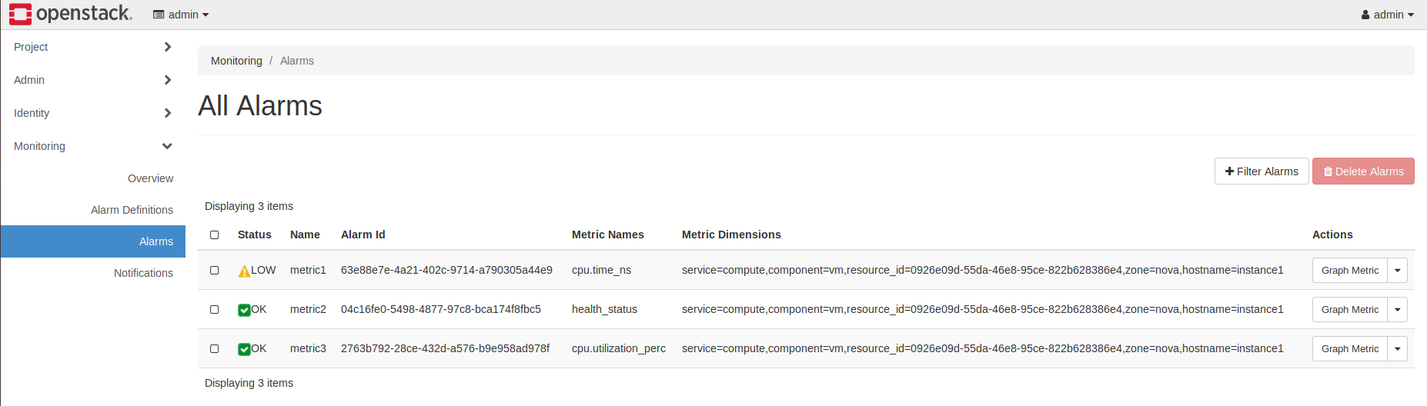
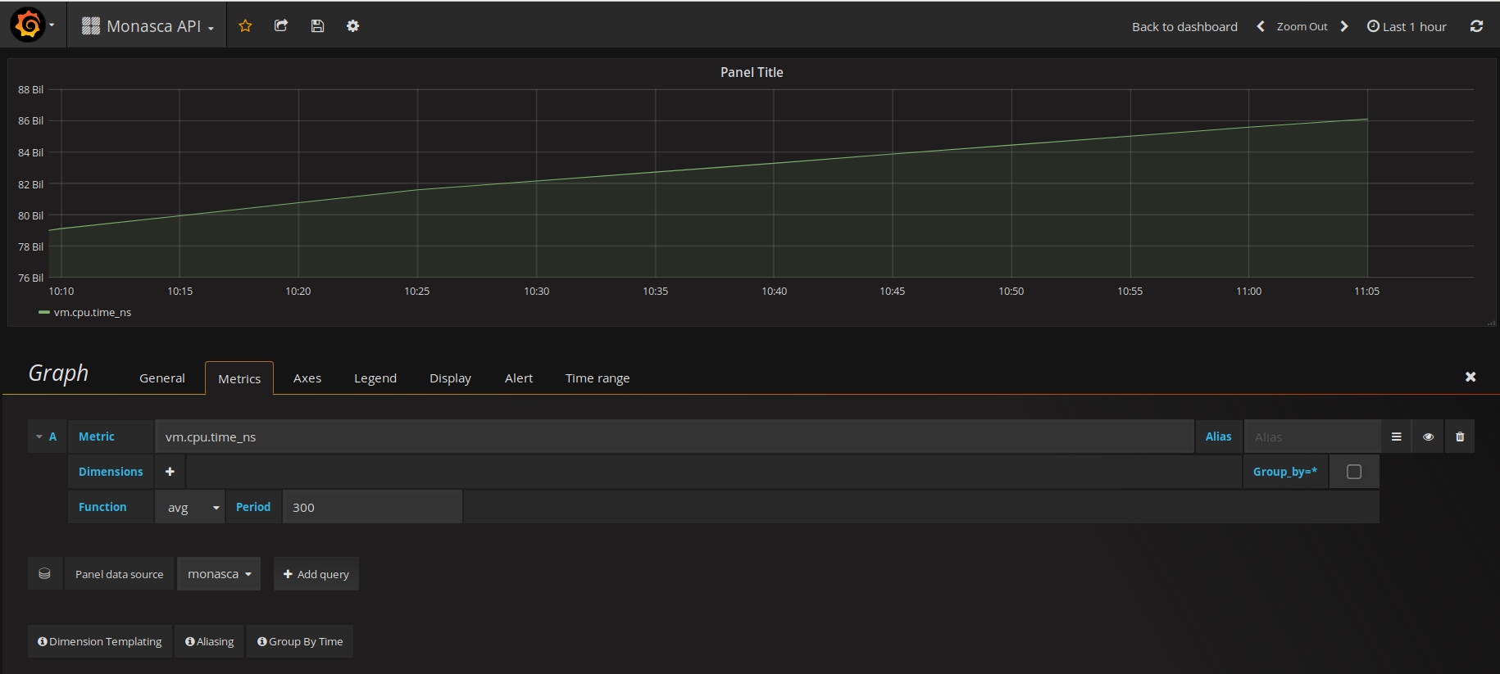
Alarms are shown in the Alarms section, and can be graphed using Grafana.
Grafana allows a wide range of options to customize the output.

Slide 21
PROMETHEUS VS MONASCA
Installation time | User Interface | Additional services | Multi-tenancy
Short | Yes | Have to be manually installed | No
Long | No, uses Graphana | Already configured | Yes
The reason differences exist is surely due to their scope.
Monasca has the objective to monitor instances on Openstack platform and has to
adapt to an environment where multiple users can reside and need an highly scalable,
performant, fault-tolerant tool to gather information and data.
Prometheus on the other hand, has become the mainstream, open source monitoring tool of choice for those that lean heavily on containers and microservices.

Slide 22
In conclusion,
Monitoring any IT system is not a simple task and in the highly dynamic
world of the cloud, it is even more complex.
In addition to the components and tools mentioned during this report, there are third party open source tools as well as multiple modern commercial ones.
In order to make a real and practical move forward, it is compulsory to first define what is needed to monitor and where to start, be it with compute consumption and usage, detailed network performance or maybe user access for security reasons.

Slide 23
Thanks
for the attention!

